Slide 1
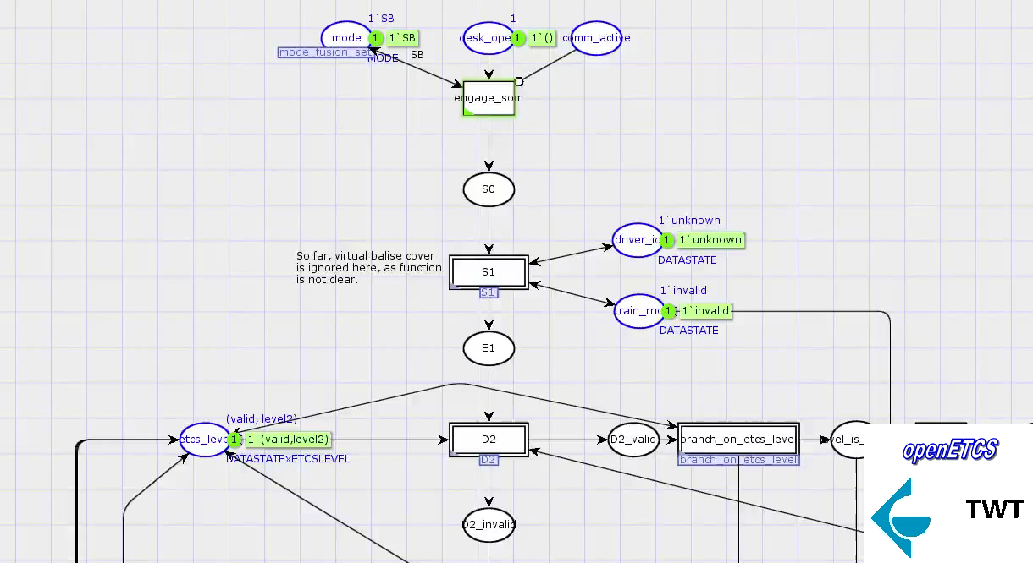
Open Proof: Verification & Validation based on Formal Methods & Simulation
Example: Formal Petri Net model of “Start of Mission”

